Slide 1
Incredible Years
Building on our kete of positive learning environments through weaving PB4L School-wide, IY Teacher and Parent together.
Notes:
5 mins
Set up: small groups depending on the side of the room.
Open with a Karakia
Warm up and orientating. Ask people what they would like from the session and write this up?
Here’s a chance to be creative, get your thinking caps on, take something back. It’s a wonderful opportunity to go through the programmes briefly, connect the dots and have a practical demonstration of the kete demonstrated by Westown School.
Need a gimic to engage that is fun, relatively quick and quite light! Small picture to big picture observations looking from details to big picture. Wider context. (You tube clip https://www.youtube.com/watch?v=tyla9p-pteU&feature=youtu.be )
Jens is one of our IY Parent mentors.... I am SW Practitioner. Westown representatives include Adrienne Ainsley, RTLB and Coach, Diane Carr, Principal and Christina Morse, Assistant Principal and Team Leader.
We hope this will all come together for you and you can approach local MOE and for example, have sessions at your school for IYP. Opportunity to work together – parent would understand the “ignore” strategy. Operating on site at school.

Slide 2
Karakia
E te (Atua)
Homai ki a mātou
Te kaha me te maramatanga
Ki a mahitika ki te tautoko
Tētahi ki tētahi
Kia haere pai i roto i tēnei (rā)
Amine
Dear (whoever that may be for us all)
Give to us
The strength & understanding
To work together and support
Each other
So today goes well
Amen
Notes:
This karakia was developed in the Waikato by Louanna and her class.

Slide 3
Mā te whiri tahi ka whakatuki ai ngā pumanawa ā tangata
Together weaving the
realisation of potential

Slide 4
Notes:
5 minutes
Shelley - Explain positive education academic and social. Positive Education brings together the science of well-being and positive psychology with best practice teaching and learning to encourage and support schools and members of the school community to flourish. Positive Education involves positive relationships, positive emotions, positive engagement, positive health, positive accomplishment, and positive purpose.
And why does Positive Education matter? The statistics on depression, anxiety, stress, and other mental health concerns in adolescents and adults are frighteningly high. It is estimated that one quarter of young people in NZ live with a mental illness. Positive Education is a proactive and preventative approach to building well-being and health in schools and communities and aims to reduce the prevalence of mental illness across the lifespan.
There is also the irrefutable fact that students who are physically and mentally well are better equipped to learn and achieve academically and more effectively manage the transition to further study or employment after secondary school.
So what does PB4L SW provide?
In the SW Framework we have
: a list of expected behaviours for students and staff which are developed collaboratively
: teachers leading the practice of social skills in and across multiple school settings
:desire social behaviour by students and staff is specifically positively and frequently acknowledged
:procedures are developed for responding to inappropriate behaviour
: data is collected around effectiveness
SW provides us with the wardrobe that we can hang other positive education programmes from or the base to weave other programmes through. These programmes include Restorative Practices, Circle Time, Social and emotional coaching, Social skills, the Friends programme and Incredible Years Teacher and Parent.
These are exciting times and we can influence the well-being and academic achievement of students beyond school.

Slide 5
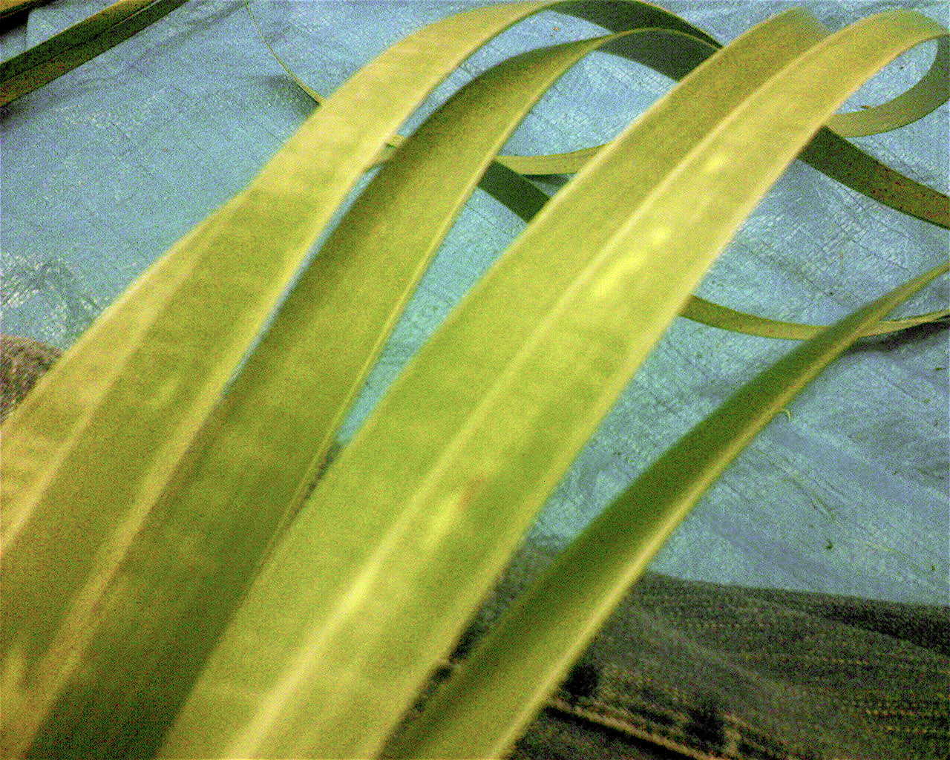
Notes:
Overview of the projects:
Let’s touch on some statistics and the numbers of schools involved in these initiatives....what does the research tell us.
SW 16 May 2016, 679 schools were participating in PB4L School-Wide with plans to double these numbers. The NZCER research in 2014 indicated schools who were part of PB4L SW had fewer stand downs, significantly less behavioural difficulties and higher academic achievements such as higher NCEA results.
In Taranaki, Juliet Lewis, went to the USA and brought back PBIS 10 years ago. This was piloted with schools in Waitara and Inglewood. The Principal of Waitara East School described his PAT levels as being increased as a result of the effective management of behaviour. This is now in all schools in Waitara and community wide with shops having vouchers for students who display appropriate behaviours.
IY
Evidence based program to support positive behaviour practices at home and in school
Group program
IYP 14 weeks (2.5 hour) - 17,769 parents
IYT 6 plus 1 booster (whole day) - 12,038 teachers
A mutualised delivery
IY methods & process + groups cultural context & experience = Fidelity (tailored delivery) [key ingredients]
Key methods and process
-Collaborative
-Relationship based
Show clip
Draw out key idea
Explore how apply to own situation
Practice – experiential learning
Try at home / school –goals set by individuals
Coaching
Report back how went
Use Teacher pyramid
Road map to content
Talk to pyramid
= result tool box that support by developing skills to create implement and monitor behaviour plan
Video
Following with IY questions
Thinking about SW as a framework (point wall essential features) ... IY becomes one of the initiatives/programs that weave into framework (soon Westown going to talk to how they have done this) but before we do lets think about your own school and community
..................................
As at 31 December 2015 17,769 parents have participated in an IYP programme and 12,038 teachers have participated in an IYT programme
SW 16 May 2016, 679 schools were participating in PB4L School-Wide
10 minutes IYT IYP are part of the weaving. Let’s imagine if the community came in and developed ideas.
.
Jens – IYT about numbers of schools. Fairly wide. Pyramid and talking through the process and steps. Behaviour Plan for teacher. (Copy of each pyramid) Teacher and parent
7 minutes....IYP parent – show the video

Slide 6
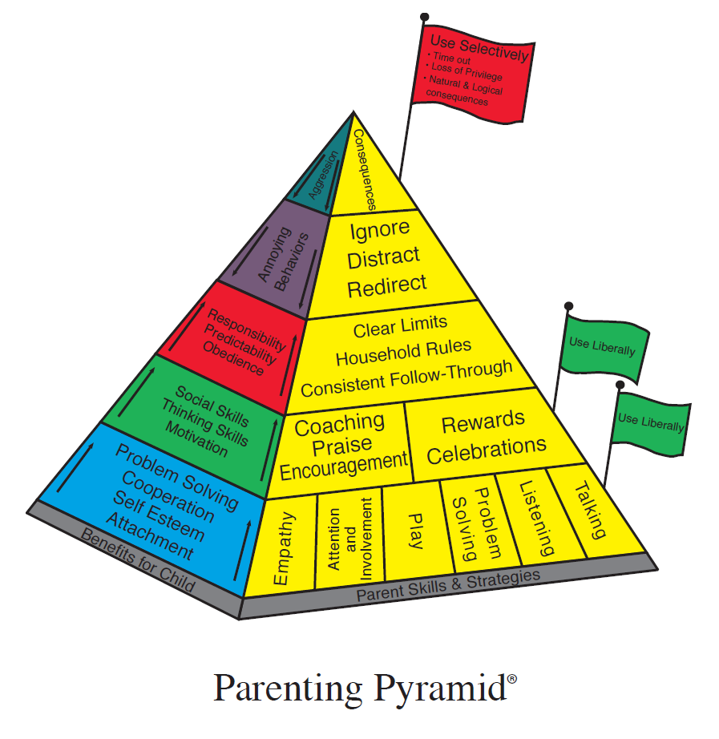

Slide 7
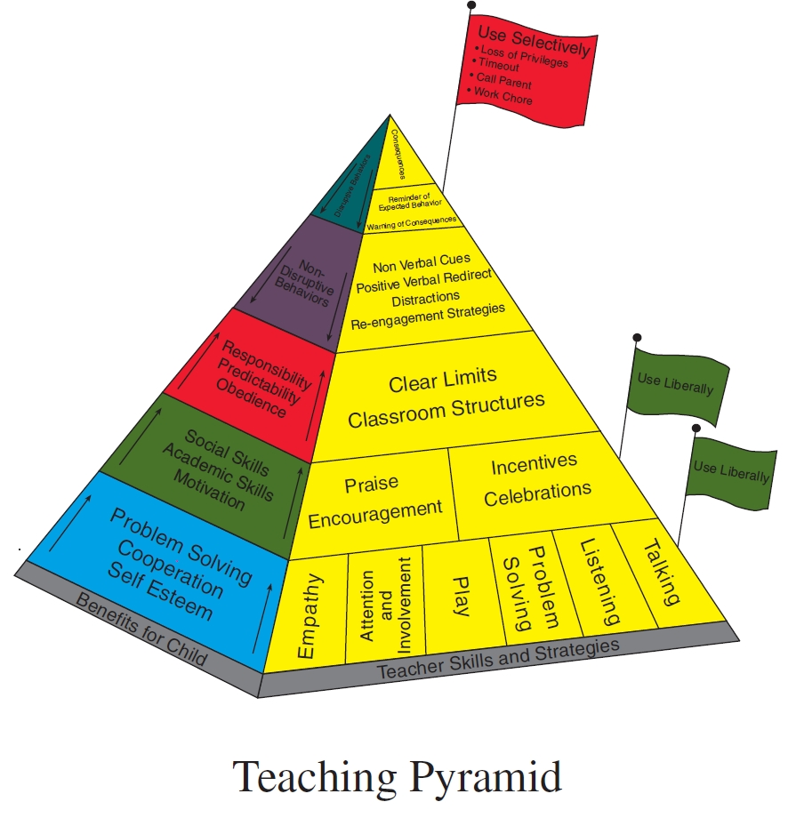

Slide 8
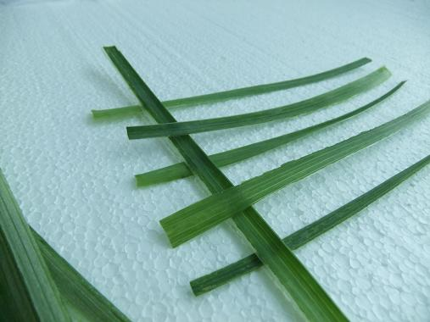
Notes:
Detail of the weave
Bring together SW framework with its hallmarks of teaching behaviour and consistency and weave in IYT & P
What could you put in the mix?
Give some example to help orientate group to activity (but leave things for them to generate)
can provide common behaviour management language to help bridge gaps between home and school around questions such as when whanua ask if they can use PB4L SW at home
creating and then sustaining ... use Peterhead School example
.......
10 minsWeaving
In using these 3 initiatives it gives us the pathways or step into more .... Grow your muscles.... Sustainability ....pathways....engagement with community. Opportunities to grow.
Shelley - Starting to connect the dots. Starting the threads. SW language and IY language (Activity with person next to you...ask for 1 or 2 examples).
Introduce Harakeke (Linda). Shelley to discuss it with Linda having a framework first then weave. Talking about the schools ideas

Slide 9
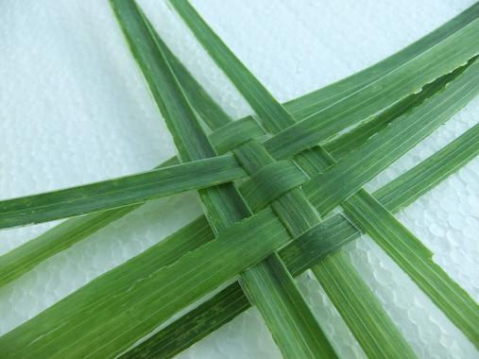
Notes:
5minutes
Debrief and key questions.....(to do)
Weaving with harakeke. How could that be useful....generate ideas. Here’s an idea where can it take you?
Embedding into the essential features. Data....behaviour plan. Changing and thinking behaviour in teachers. Key competencies. training all staff in IYT including Teacher Aides and Principals
When parents ask if we can have SW for our home ... advantages of common behaviour language and strategies

Slide 10
Notes:
Introducing Westown School and keep this slide up..

Slide 11
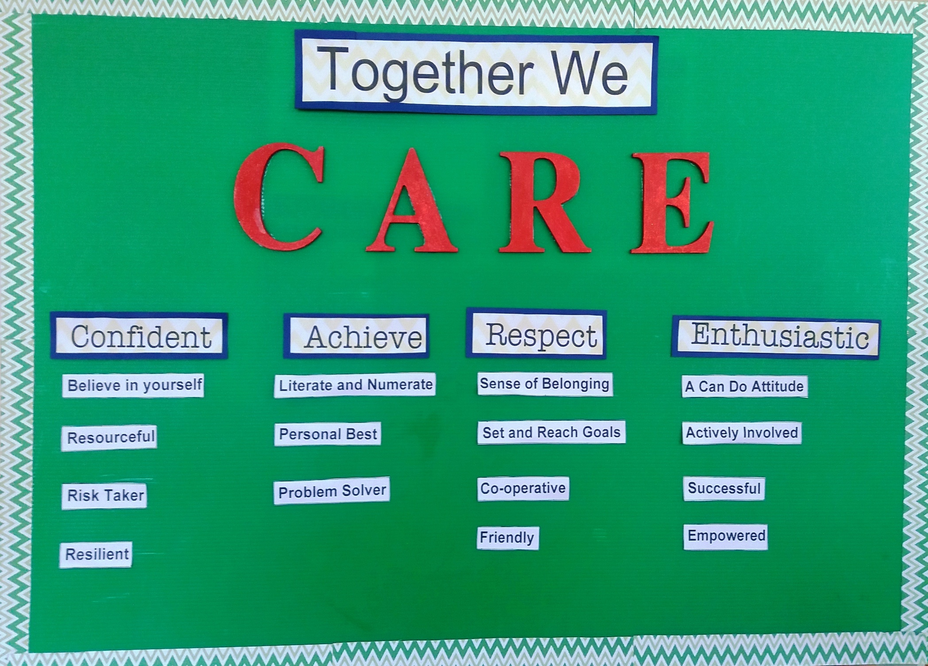

Slide 12
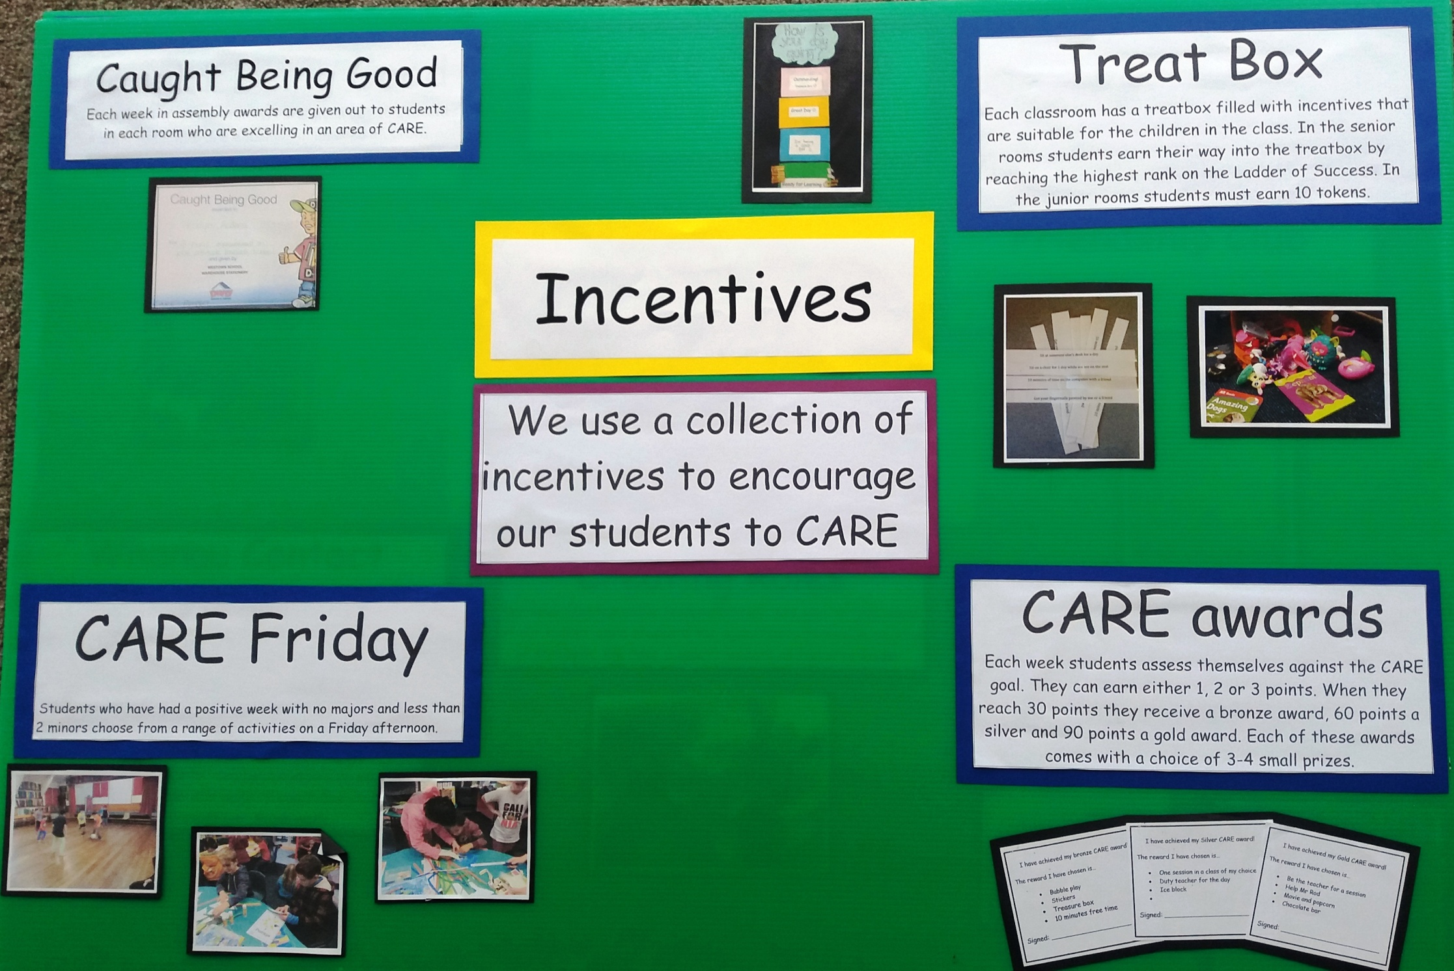

Slide 13
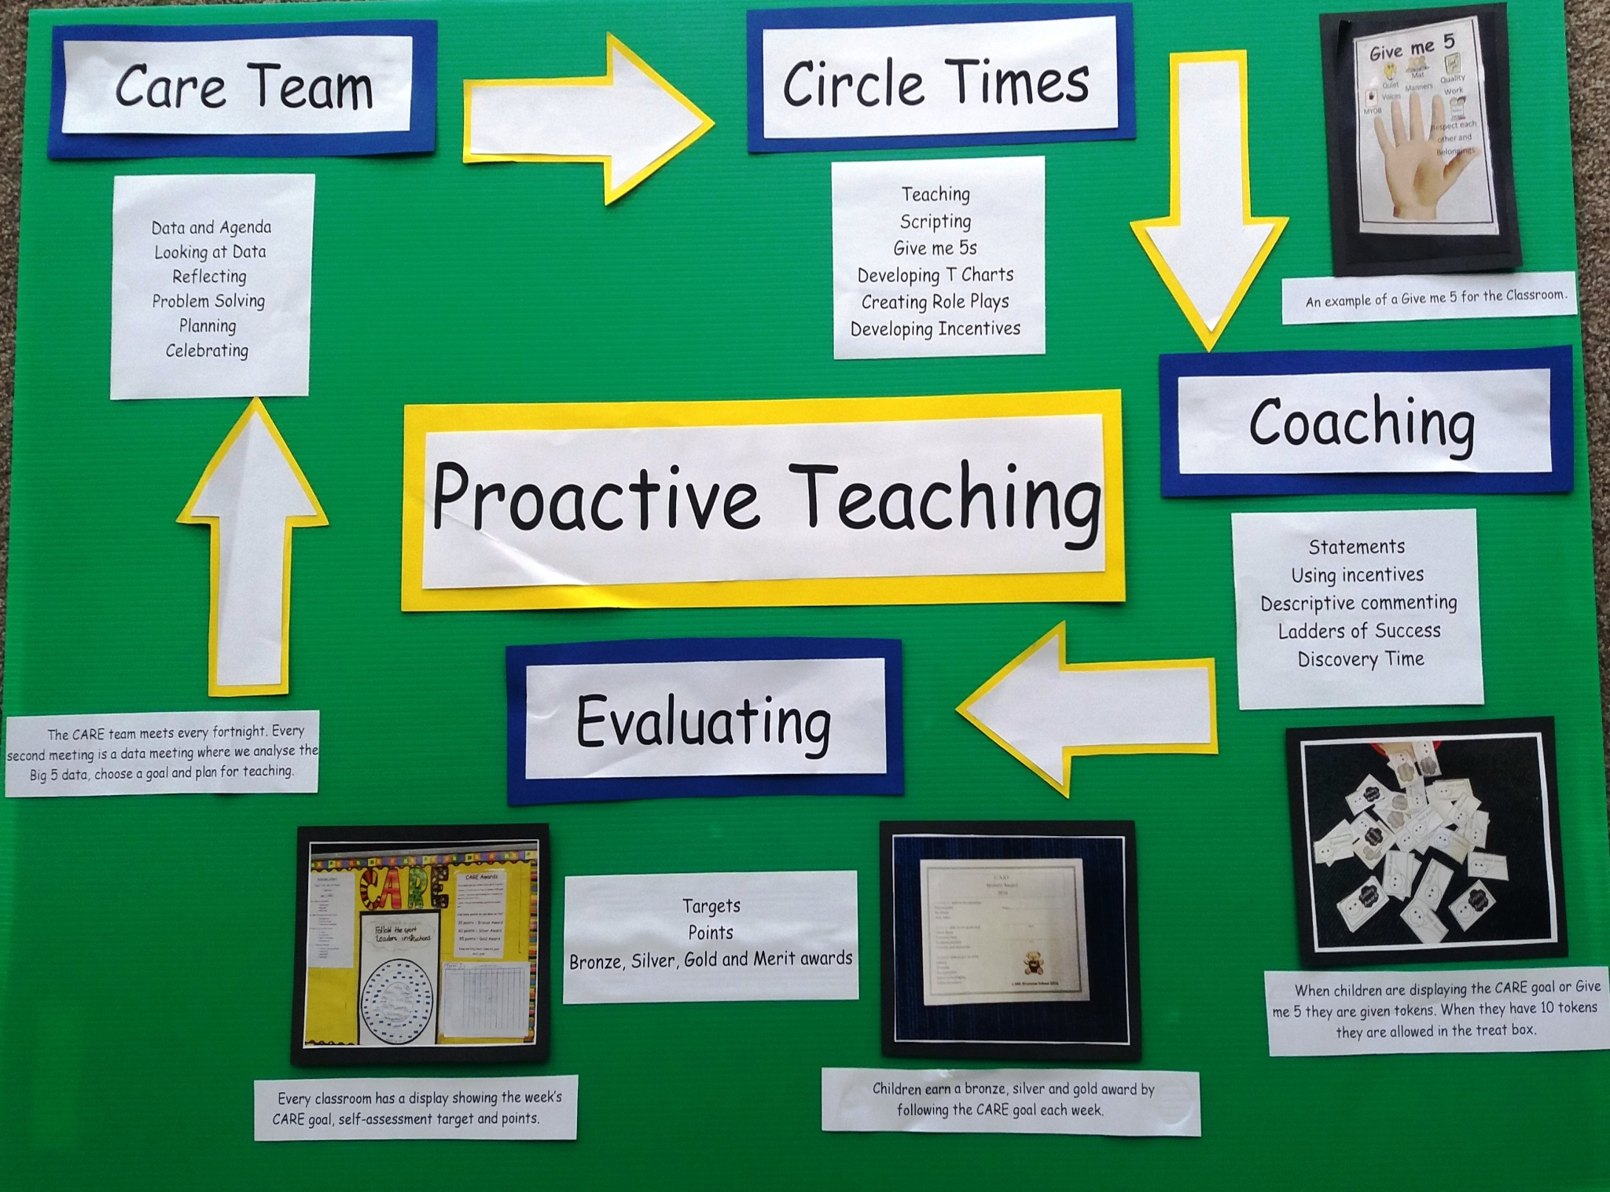

Slide 15
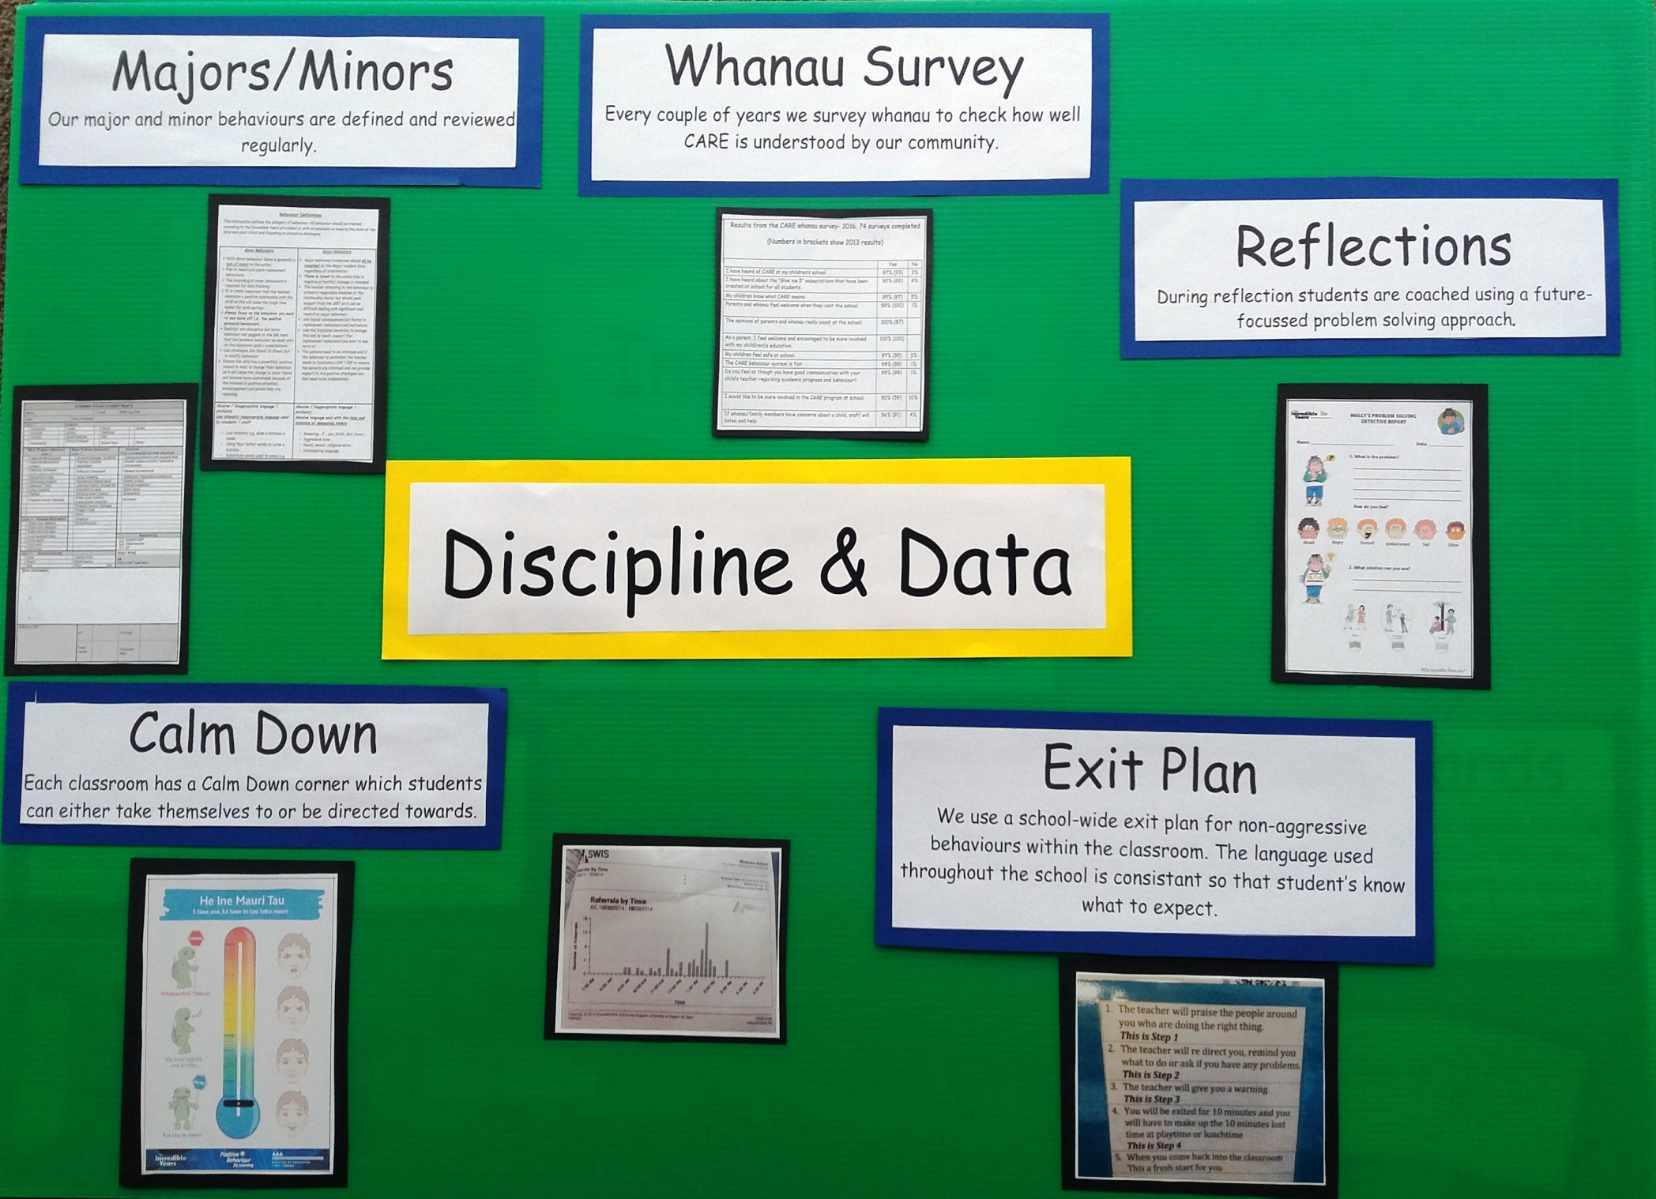

Slide 16
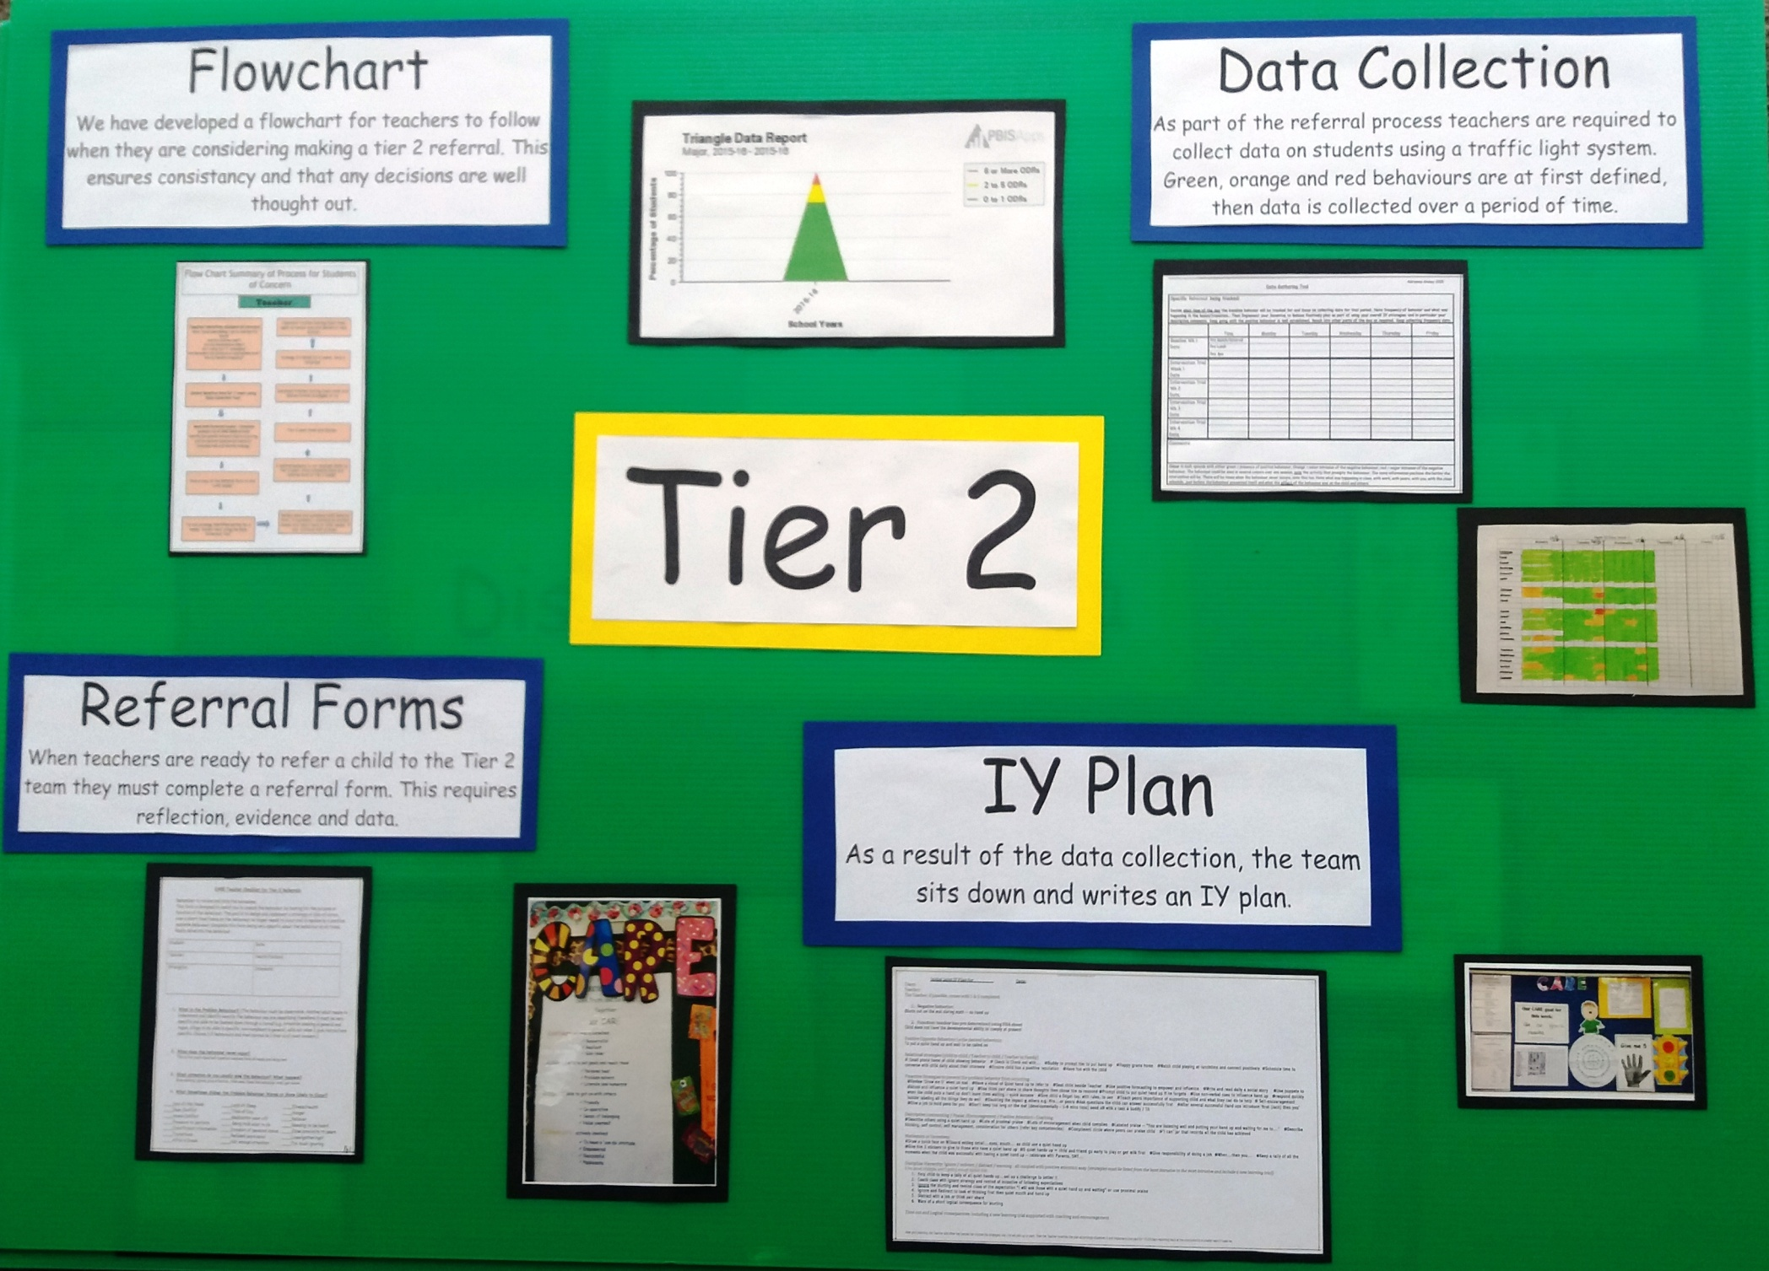

Slide 17
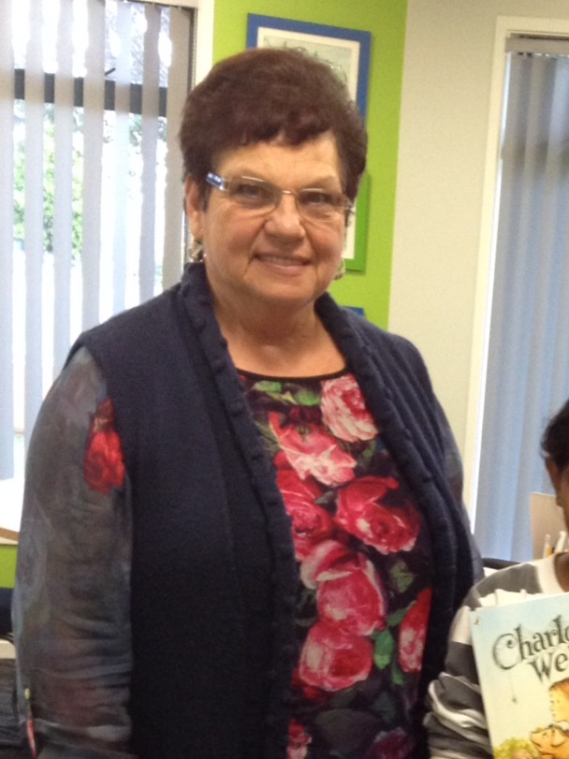
Our Principal’s Perspective…

Slide 18
Why did we go school-wide and IY?
Staff were in a reactive mode, not proactive
Teacher felt ownership of their class, but not the rest of school
Junior staff were afraid to interact with senior children, causing a division between junior and senior teachers.
Children didn’t know what the expected behaviours were meant to look like
Social skills weren’t being taught
Different rules and interpretations of these rules in classrooms
Teachers were backing children into corners and leaving them no option but fight or flight
Teachers and whanau saw the principal as the person who had to be the disciplinarian
There was a lot of negative talk about ‘naughty kids’ in the staff room
There were explosive physical fights in the playground, and children were not able to manage their anger
Staff had regular mental health days!

Slide 19
What have been the philosophical changes and benefits at Westown since implementing these?
Children are no longer ‘naughty kids’ – more holistic view that looks at the function of the behavior.
Childen are given ownership over their behaviour - choices
Behaviour is taught through circle times, role plays etc. – not just expected.
It is ok to offer incentives and give rewards to children who don’t get everything right but achieve their behavior goal. IY Gave teachers the ok to do this
Relationships were a huge focus and teachers understanding of what relationships meant
Conversations between staff were more frequent, reflective and brought staff together in their support
Whole school ownership of students
Teachers have conversations on duty with students
Restorative scripts are used in the playground
No longer punishment- reflections are used to reflect on behaviours in situations and how to do things differently next time
Consistent approach across the school to managing behaviour

Slide 20
IY brought about the changes that saw it go from the classroom out to the playground- it became embedded and developed into our culture
Both children and staff share a common language
All teaching staff are a member of CARE committee and meet once a fortnight-the key to keeping it alive
The school environment is positive and supportive
Students are acknowledged for their good choices in behaviours- many layers of rewards, acknowledgments
Undesirable behavior is dealt with in a fair, predictable and equitable way
Increase in attendance and academic performance, reduction in bullying behaviours
Children are very supportive of each other and do a lot of coaching in the playground when children are in unacceptable situations. This is the best part!!!! From juniors to seniors They also go home and teach their parents what to do when they get angry
They are very aware of their own and others feelings and can articulate these.
CICO with Principal- Relationship with target at risk students- build up relationships with these children so that I can then coach/mentor them and assist them to take control of their behaviours.
Teachers no longer fear any of the children- have the tools to deal with situations and the knowledge that they are supported by staff, Principal, parents BOT

Slide 21
How has implementing IY and School-Wide changed my job as a principal?
I am no longer seen by staff as the person who has to sort out the discipline! I am in a supportive role to the teachers and I can have positive relationships with the children. We do it together.
Staff absences have dropped dramatically- no more mental health days. Example: This year we have had 7 sick days collectively as a teaching staff and two of those days were to look after sick family members. I am able to use this funding to support learning initiatives
Being able to leave the school without feeling stressed about what would be happening without me there
Able to be a coach/mentor rather than a disciplinarian
Have more positive interactions with parents- able to coach them
Spend more time on curriculum – not constantly dealing with one crisis after another
My stress levels have decreased

Slide 22
I believe that we have been able to successfully implement school wide because of the following key factors:
A very competent RTLB as a coach who was respected by both myself and my staff. Reflective conversations, professional readings, accessible.
A motivated leader who co-ordinates all the meetings and activities and is a very good role model of all the beliefs of CARE
Believing in our vision – TOGETHER WE CARE
Principal supporting and believing in PB4L and IY 100%
An amazing staff who have been on the journey and are constantly upskilling themselves and supporting one another. Taking ownership of all the children in the school. Being open to challenging their beliefs and making huge changes in the way they interact with children
Whole school staff development – we do it together not juniors /seniors
Having new staff trained in IY as soon as they come into our school.
Having all staff on our CARE team and regular meetings
Induction for new staff and CARE club for new students
Tangible rewards

Slide 23
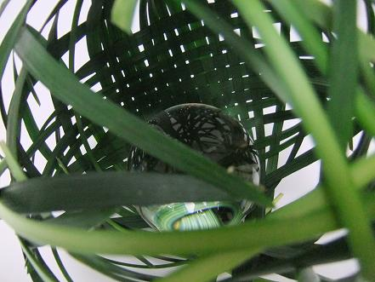
Notes:
Call to action
(2min) Link zoom ... we have been looking at detail and examples of what we can do (link examples) now we are going to move further into a creative space and step back at a big picture level ... What's you vision?
Move from the detail of our weave to what we could create with that weave
Question to group: Looking at the weaving in the slide who are you going to put at the centre? Who is the weave for?
Brainstorm: What are the benefits of weaving together of SW and IY? (benefits for students, school, teachers, whanua , community) - chart
......
15 minute activity.
Stepping back big picture (Jens). Community, parent programme. Wondering, ideas, possibilities.
Joining the dots.... Heard from the school....How can we action our ideas? What’s the plan?
Develop a card with “Next steps”

Slide 24
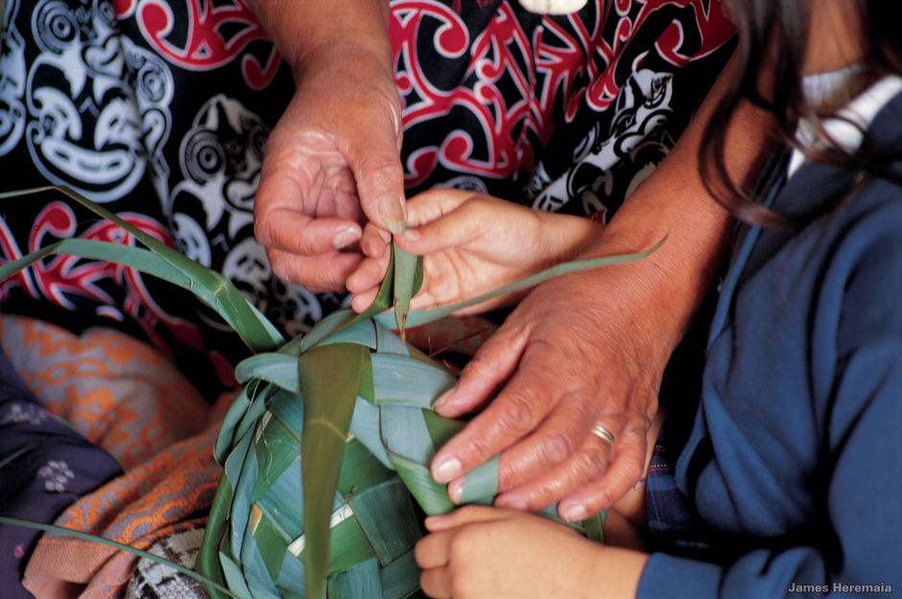
Notes:
(3min)
With [ ] at the centre let’s start to think about who might be involved in the weaving
how are we as a school are we thinking we would like to interact with this group? Is our goal for them to ...
Attend / Engage / Invest
(outline example of whanua as a part of this group)
Attend = school shares information e.g. school 3 to 5 expectations ‘here they are’
Engage = whanua interact with school e.g. ‘here are our ideas what do you think?’
Invest = whanua key player in developing e.g. ‘we are looking to develop 3 to 5 what do you think?’ -they are weavers and integral to deciding what is created
Activity:
(5min) If we think about how the arrival of the 3D printer changed our concepts around what could be printed lets now take some time to think about what might be possible for us to create if we were to become 3D weavers ... Big picture visions
In your groups start to think about and discuss your own school and its community and what it could mean if you were to 3D weave with SW, IY T & P
What is your vision? What dos it look like?
On your card capture your vision & next steps
*****Activity with harekeke, weaving and bringing things together.
A call to action.... Goal setting. Going away to talk to someone about (Ideas cards....)
It takes a whole community to raise a child. Imagine if parents were part of the IYP and using the same language e.g. “praise” Tier 1 . Other ideas .
Start on community... Start a thread into the community... Personalised weaving.

Slide 25
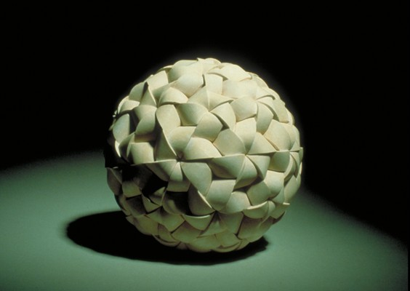
Notes:
(5min) Bring group back together
Let’s have a look at some of the 3D weaving you have been discussing
Questions (what’s coming up for people?)
Share 3D weave (vision) then follow up with what’s your next step (If we are not yet master weavers where to next?)
What are the benefits? Who are they for? What is the value? What would we see? How would [ ] feel?
Feedback, summarise, different ideas. Everyone has a role and relationship with the child. Wrapping around the child. Creating something that is special and unique ... Spark and ideas
up so many options

Slide 26
Notes:
Wrapping up

